Slide 1

MACHINE LEARNING DETECTION OF FOREST FIRES
Nile Coble Weekly Review

Slide 2
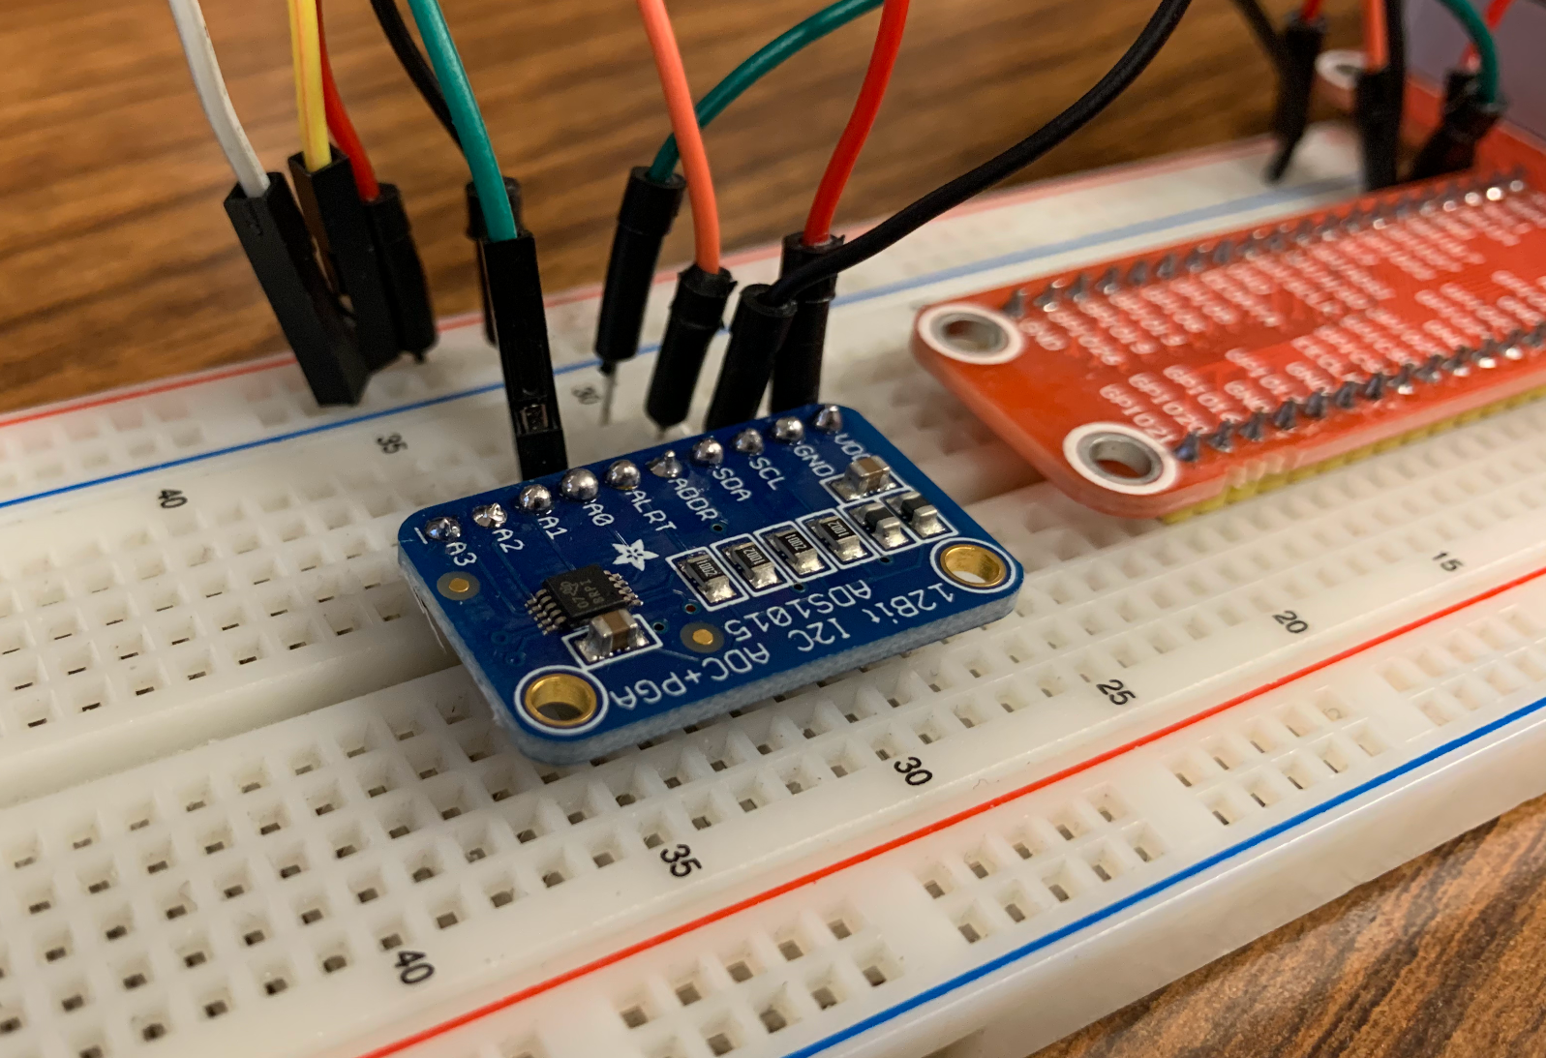
Upgraded to ADC able to sample at 3300 Hz.
New issue: cannot record samples
fast enough

Slide 3
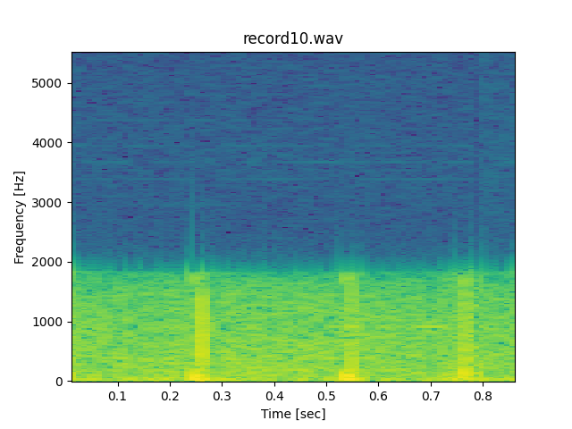
Next Up:
Better microphone
Produce binary spectrogram & PCA from
microphone data

Slide 4
THANK YOU

